Slide 1
Lecture 4
Stability of IVP Solvers

Slide 2











Introduction
In previous lectures we learned how to use Euler’s method
An open question was : how do we choose the step size $h$?
$$y$$
$$w_{i+1}=w_{i}+hf\left(t_{i},w_{i}\right)$$
$$w_{i+1}$$
$$f(t_{i},w_{i})$$
$$hf(t_{i},w_{i})$$
$$w_{i}$$
$$t_{i}$$
$$t_{i+1}$$
$$t$$
$$h$$
Notes:
In the previous lectures we learned how to use Euler’s method
An open question was : how do we choose the step size $h$?
In this lecture we want to start to answer this question.
We will study a particular case and analyze how the choice of the step-size h affects the solution process

Slide 3

A case study
We consider the following IVP problem:
$$\left\{\begin{aligned}\frac{dy}{dt}=−βy \\ y\left(0\right)=y_{o}\end{aligned}\right.$$
with $β>0$
Notes:
We consider a simple initial value problem
The ODE is $\frac{dy}{dt}=−βy$ where $β$ is a positive number
And the initial condition is y(0)=yo

Slide 4
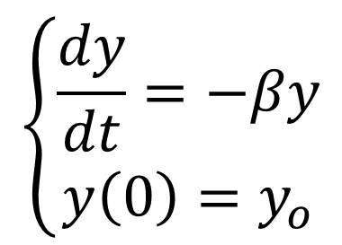
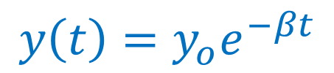



A case study – True Solution
$$y$$
$$y_{o}$$
$$\left\{\begin{aligned}\frac{dy}{dt}=−βy \\ y\left(0\right)=y_{o}\end{aligned}\right.$$
$$y\left(t\right)=y_{o}e^{−βt}$$
$$t$$
Notes:
It is not hard to solve this IVP analytically
I invite you to try by yourself
The solution is $y\left(t\right)=y_{o}e^{−βt}$
This is a function which becomes closer and closer to zero as t increases
We may expect that the numerical solution process should be quite stable
Indeed, any error that would accumulate as we progress with Euler’s method will probably be reduced.

Slide 5
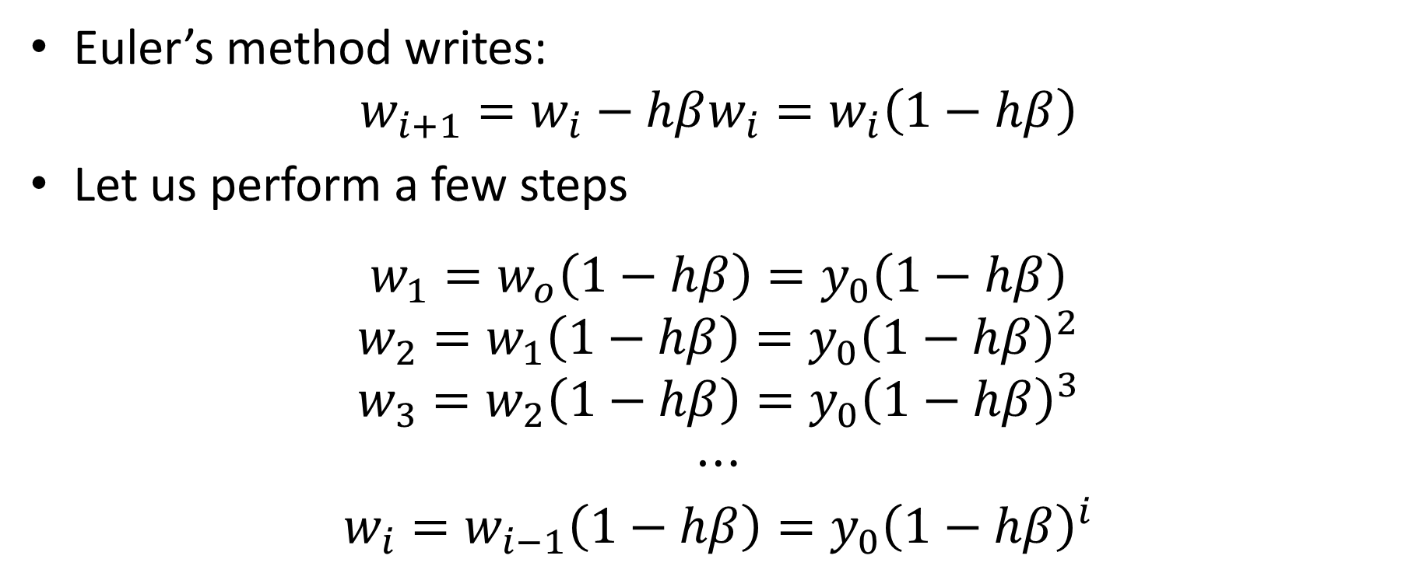
A case study – Numerical Solution
Euler’s method writes:
$$w_{i+1}=w_{i}−hβw_{i}=w_{i}\left(1−hβ\right)$$
Let us perform a few steps
$$w_{1}=w_{o}\left(1−hβ\right)=y_{0}\left(1−hβ\right)$$
$$w_{2}=w_{1}\left(1−hβ\right)=y_{0}{\left(1−hβ\right)}^{2}$$
$$w_{3}=w_{2}\left(1−hβ\right)=y_{0}{\left(1−hβ\right)}^{3}$$
$$⋯$$
$$w_{i}=w_{i−1}\left(1−hβ\right)=y_{0}{\left(1−hβ\right)}^{i}$$
Notes:
Let us now apply Euler’s method
The algorithm writes as
$$w_{i+1}=w_{i}−hβw_{i}=w_{i}\left(1−hβ\right)$$
Let us now perform some steps
$$w_{1}=w_{o}\left(1−hβ\right)=y_{0}\left(1−hβ\right)$$
If we do one step further we obtain
$$w_{2}=w_{1}\left(1−hβ\right)=y_{0}{\left(1−hβ\right)}^{2}$$
Similarly we get
$$w_{3}=w_{2}\left(1−hβ\right)=y_{0}{\left(1−hβ\right)}^{3}$$
We can go on like this as long as we wish
Probably you will have guessed how we can write a general formula for wi
We get
$$w_{i}=w_{i−1}\left(1−hβ\right)=y_{0}{\left(1−hβ\right)}^{i}$$

Slide 6
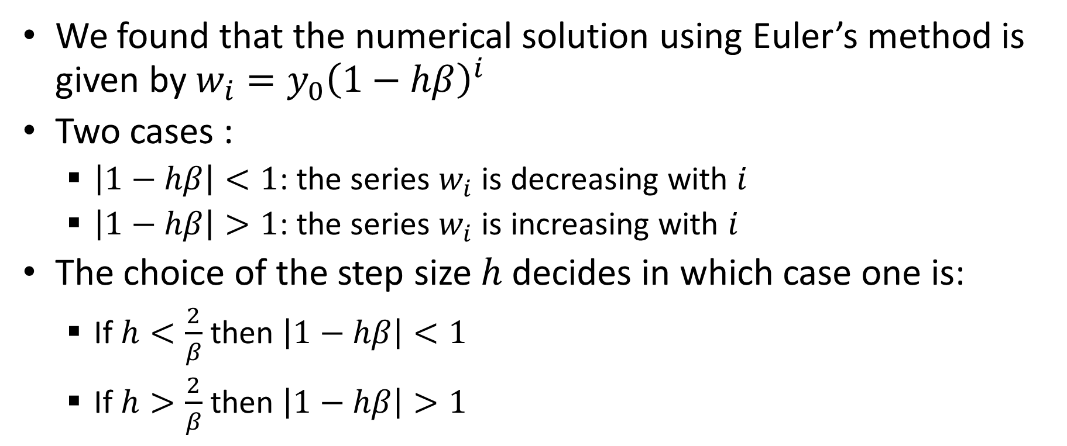
Case Study – Qualitative behavior
We found that the numerical solution using Euler’s method is given by $w_{i}=y_{0}{\left(1−hβ\right)}^{i}$
Two cases :
$\left|1−hβ\right|<1$: the series $w_{i}$ is decreasing with $i$
$\left|1−hβ\right|>1$: the series $w_{i}$ is increasing with $i$
The choice of the step size $h$ decides in which case one is:
If $h<\frac{2}{β}$ then $\left|1−hβ\right|<1$
If $h>\frac{2}{β}$ then $\left|1−hβ\right|>1$
Notes:
We found that the numerical solution using Euler’s method is given by $w_{i}=y_{0}{\left(1−hβ\right)}^{i}$
Let us examine how this numerical solution behaves
We can distinguish two cases
If $\left|1−hβ\right|<1$, the series $w_{i}$ is decreasing with $i$
On the other hand if $\left|1−hβ\right|>1$: the series $w_{i}$ is increasing with $i$
Keeping in mind the true solution of our IVP, we can conclude that the first case has a good chance to give good approximations
However the second case, where wi is increasing instead of decreasing, the approximations computed by Euler’s method is totally wrong
What decides in which case we are?
The choice of the step size $h$ decides in which case one is:
If $h<\frac{2}{β}$ then $\left|1−hβ\right|<1$
If on the contrary $h>\frac{2}{β}$ then $\left|1−hβ\right|>1$

Slide 7
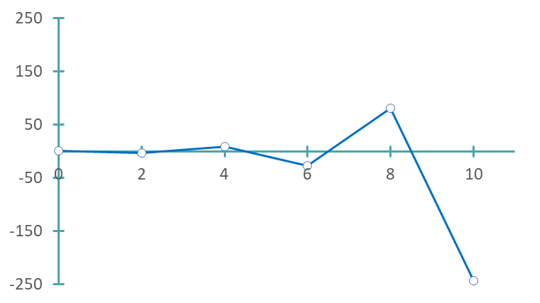

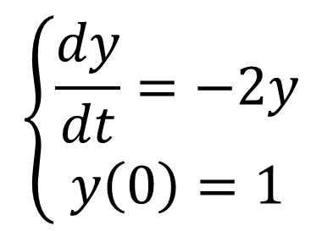
Illustration
$$h=2>\frac{2}{2}=1$$
$$\left\{\begin{aligned}\frac{dy}{dt}=−2y \\ y\left(0\right)=1\end{aligned}\right.$$
Unstable solution
Notes:
To illustrate our findings let us solve the IVP for the case where $β=2$.
If $β=2$, the critical value for h, which determines in which of the two cases on is, is equal to $β/2$ which is 2/2=1
As first example we choose h=2. This is is larger than the critical value of 1
Solving using Euler's method results in the displayed approximation
As one can observe, the approximation resemble in nothing to the true solution
It is in fact growing and growing
In numerical analysis, solutions which don’t resemble in anyway to the true solution are called unstable solutions.
Note that there exists a more rigorous definition but we don’t need to use it in this semester.

Slide 8
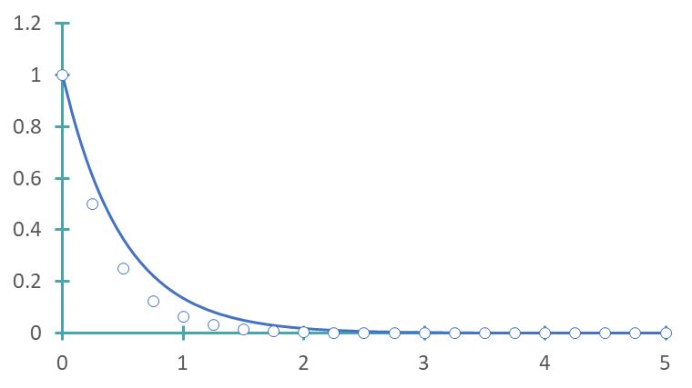
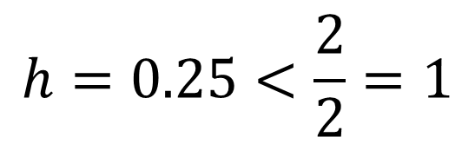
Illustration
$$h=0.25<\frac{2}{2}=1$$
$$\left\{\begin{aligned}\frac{dy}{dt}=−2y \\ y\left(0\right)=1\end{aligned}\right.$$
Stable solution
Notes:
Lt us now consider h=0.25
This value is smaller than the critical value of 1
This time, the produced numerical approximation does resemble to the true solution
On the graph the numerical approximation are the circles, whereas the true solution is the continuous line
The approximation presents some significant error, but qualitatively it behaves correctly
We say that the solution is stable

Slide 9
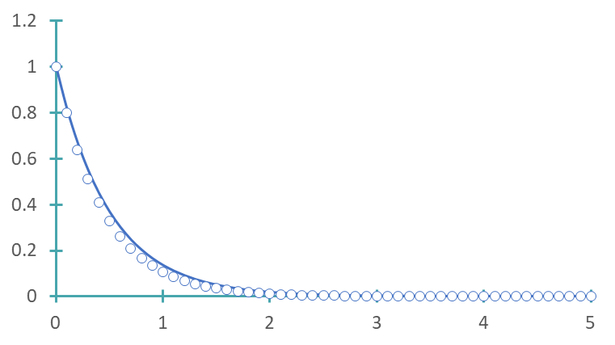
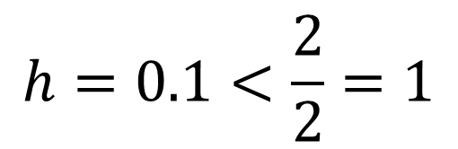
Illustration
$$h=0.1<\frac{2}{2}=1$$
$$\left\{\begin{aligned}\frac{dy}{dt}=−2y \\ y\left(0\right)=1\end{aligned}\right.$$
Stable solution
Notes:
As last example let us use h=0.1
This is smaller than the critical value of 1, but as well smaller than the value of h used in the previous slide
The numerical solution (the circles) follows now quite closely the true solution (the continuous line)
Again the solution is stable
We observe as well that as the step size h is choosen smaller, the approximation tends to become better and better

Slide 10
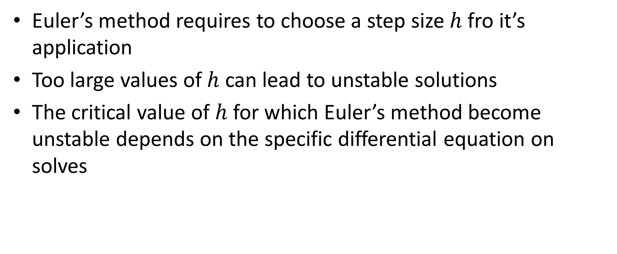
Summary
Euler’s method requires to choose a step size $h$ fro it’s application
Too large values of $h$ can lead to unstable solutions
The critical value of $h$ for which Euler’s method become unstable depends on the specific differential equation on solves
Notes:
Let us summarize the key findings
Euler’s method requires to choose a step size $h$ fro it’s application
Too large values of $h$ can lead to unstable solutions
sThe critical value of $h$ for which Euler’s method become unstable depends on the specific differential equation on solves

